Slide 1
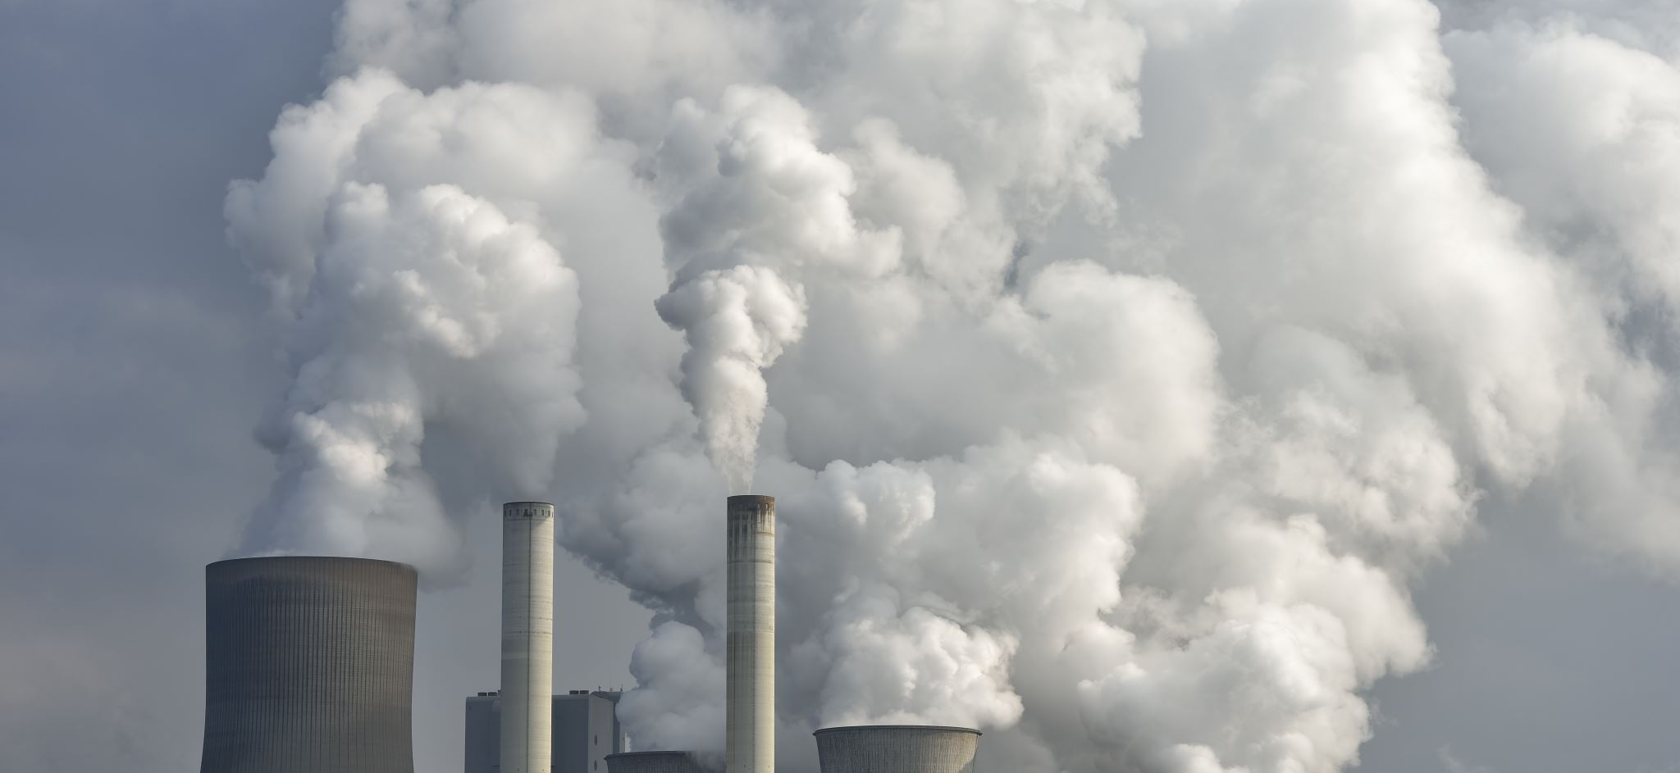

Plants versus CO₂
Does the vegetation of a specific region suffice to compensate the CO₂ emissions of this exact region?
Seminar: GIS Analyses using FOSSGIS
Lecturer: Christina Ludwig
Presented by: Niko Kolaxidis & Tobias Romes
University of Heidelberg

Slide 2


Introduction
Does the vegetation of a specific region suffice to compensate the CO₂ emissions of this exact region?
1. Classification of the region: vegetated areas vs. non-vegetated areas
2. Calculation of CO₂ sequestration ability in considered area
3. Comparison of CO₂ emissions and sequestration ability

Slide 3
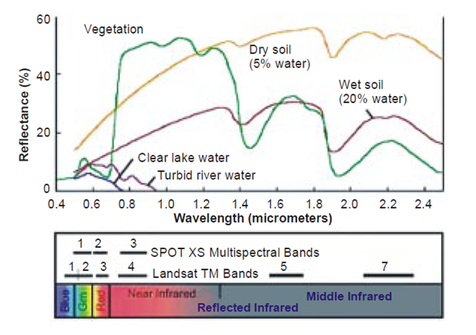
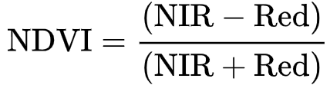
NDVI
- Normalized Difference Vegetation Index
- Unique spectral reflection of vegetation
- Calculate photosynthetic activity, vitality and density through formula:
Source: Mkansi 2017

Slide 4
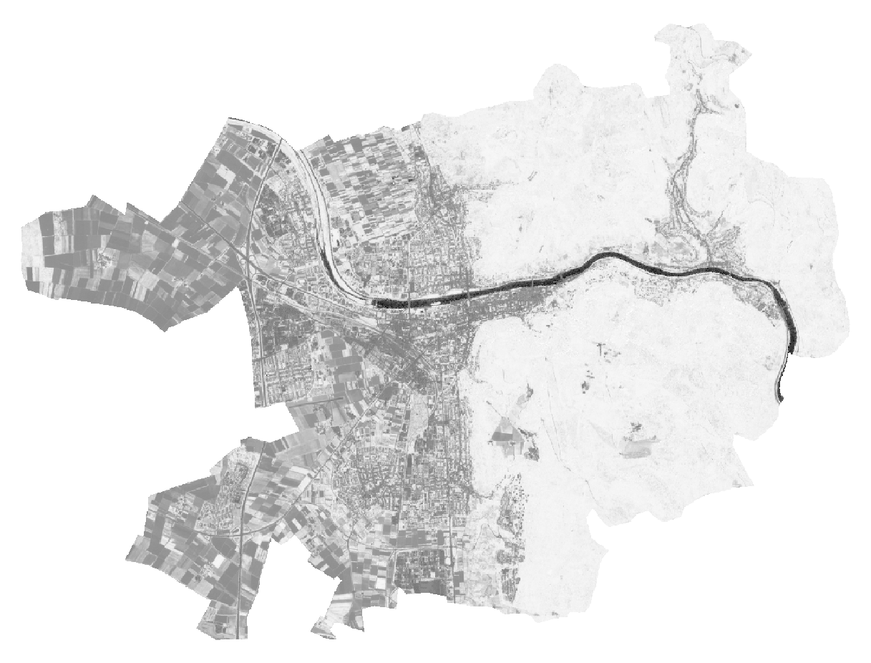
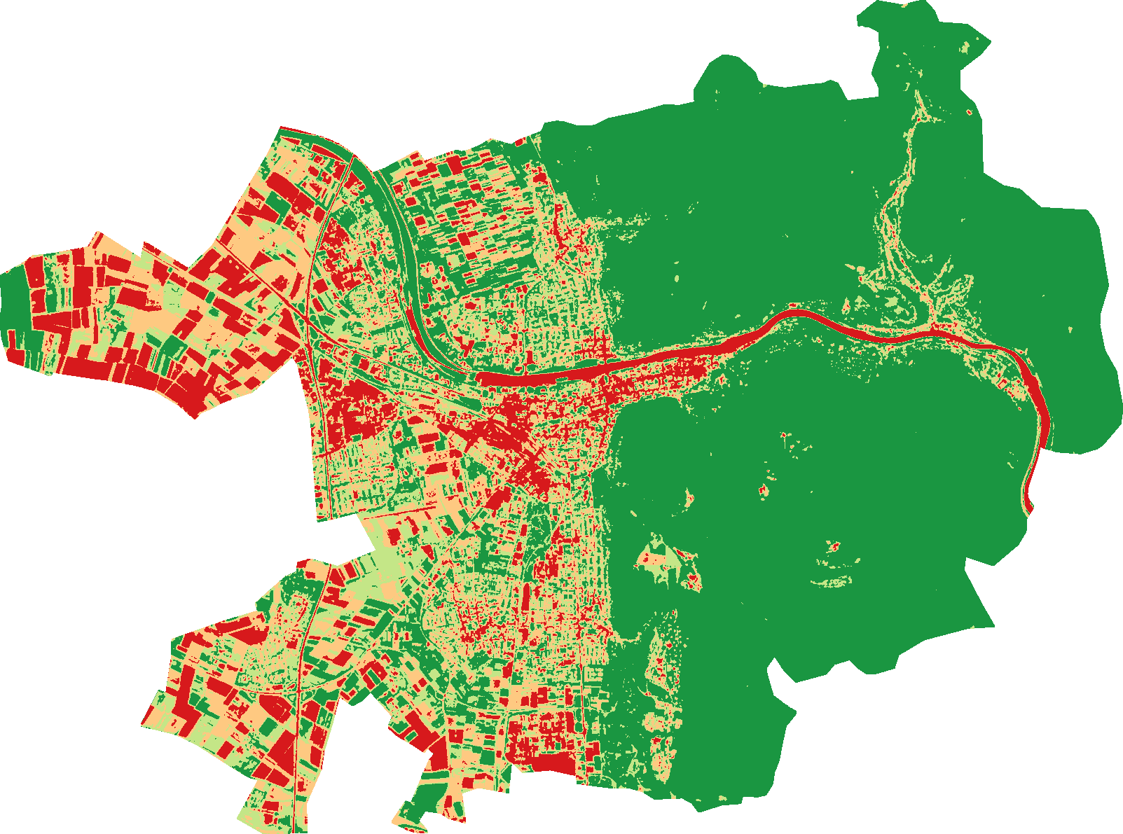
NDVI
Areas | Value
No Vegetation | -1 – 0.2
Low level of vegetation (shrub/grass) | 0.2 - 0.4
Medium level of vegetation (crops) | 0.4 - 0.6
High level of vegetation (forest) | 0.6 - 1
Source: own figure

Slide 5
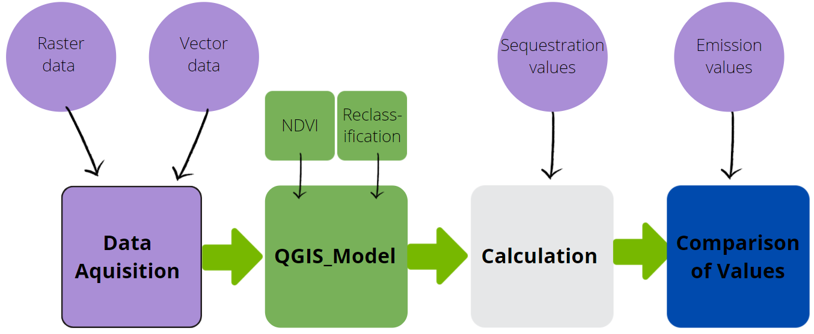
Workflow

Slide 6
Requirements
Data:
Multispectral raster data
Vector data (city outlines)
CO₂ emission data
Annual amount of CO₂ fixed by vegetation
Software:
NDVI calculation tool
Classification tool
Spreadsheet (Excel)

Slide 7
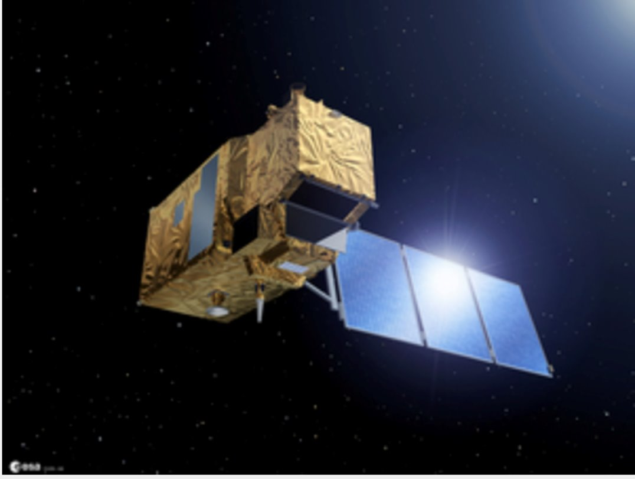
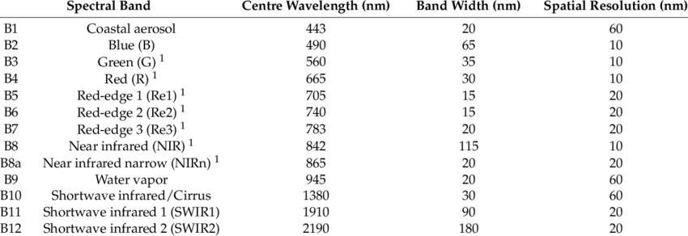
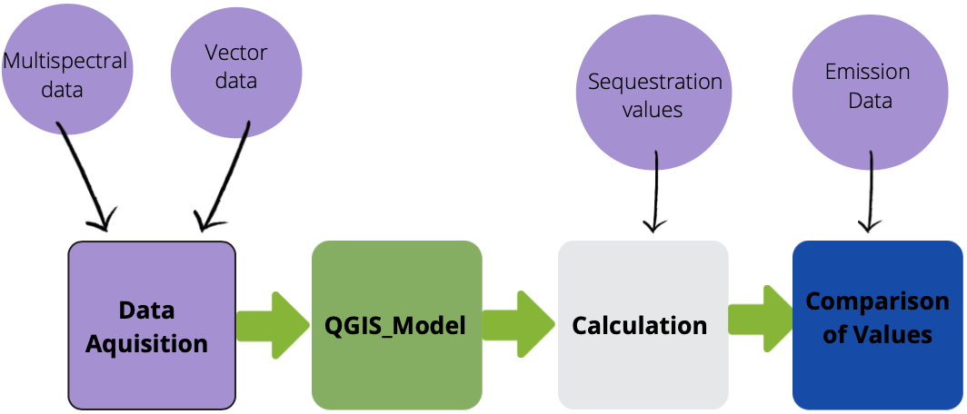
Raster data from Sentinel 2
Source: Copernicus.eu
Source: Zheng et. al (2018)

Slide 8
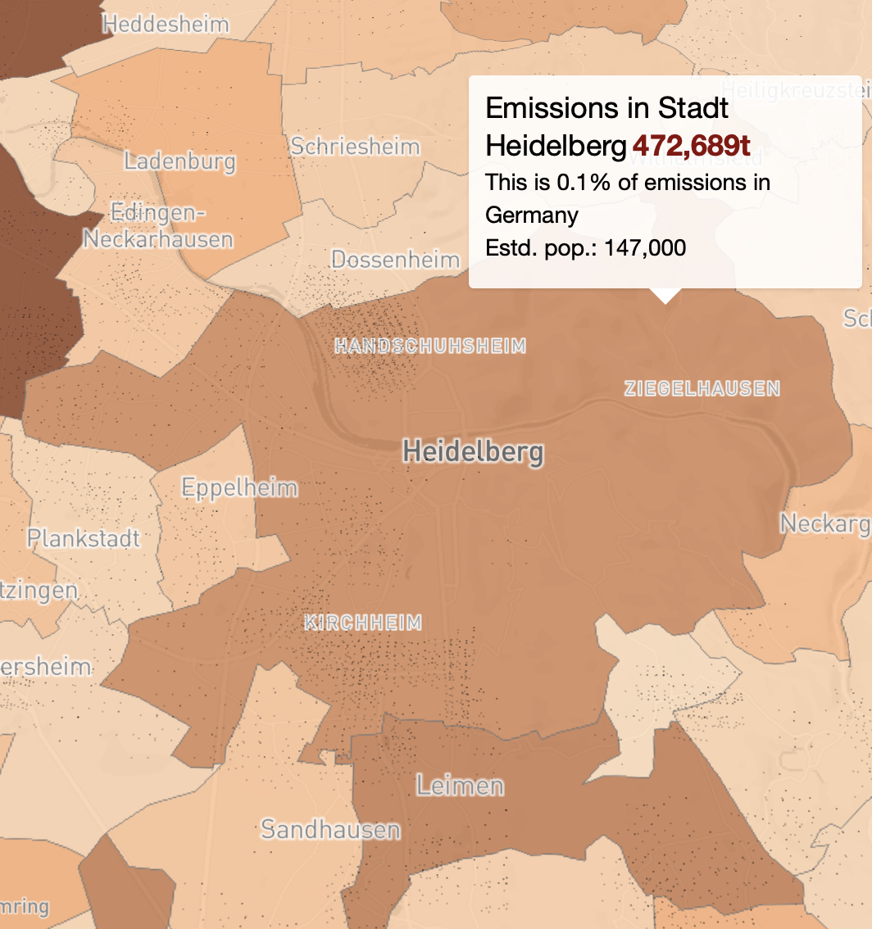
CO₂ emission data
- OpenGHGmap.net
- Available free for Europe
- Output: one value (e.g. Heidelberg: 472,689 t CO₂/year)
- Administrative level up to small towns
- Con: Data only for year 2018
Vector data
- gadm.org
- Vector data available for whole world
- Administrative level up to small towns
- Current data
- Output: Geopackage or shapefile
Source: OpenGHGMap.net

Slide 9

Extracting the region of interest (roi)
echo Enter the region of interest (roi):
set /p roi=
ogr2ogr -f "ESRI Shapefile" ./data/%roi%.shp -lco ENCODING=UTF-8 -t_srs EPSG:25832 -sql "SELECT * FROM gadm36_DEU_3 WHERE NAME_3='%roi%'" ./data/gadm36_DEU.gpkg
e.g. Heidelberg
./data/Heidelberg.shp
'Heidelberg'

Slide 10
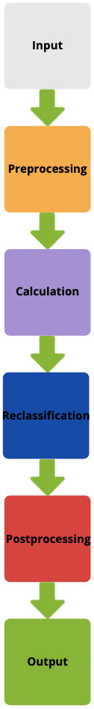
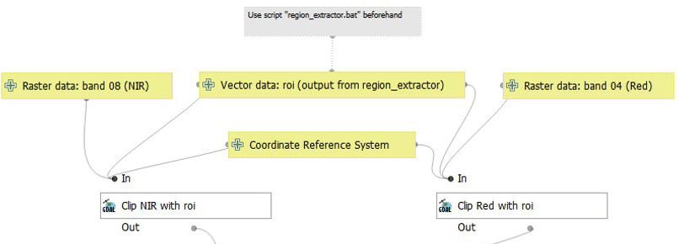
Automation: QGIS model

Slide 11
Comparison: Raster Calculator
Raster Calculator: QGIS
+ fast (2 sec for Heidelberg)
+ easy to use
-- needs to output into a file, therefore difficult to implement into Graphic Modeler
o slightly less values (pixels) → ?
Raster Calculator: SAGA
- slow (40 sec for Heidelberg)
+ easy to use
++ easy to implement into Graphic Modeler
o slightly more values (pixels) → different values

Slide 12
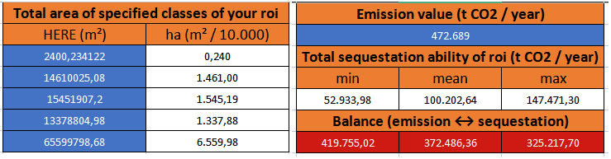
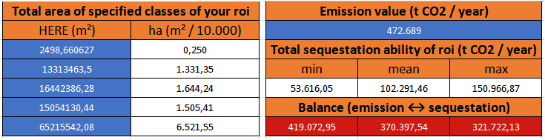
Comparison: Raster Calculator
Calculated with values from QGIS
Total: 10.904,29 ha
Source: own figure
Calculated with values from SAGA
Total: 11.002,29 ha
Source: own figure

Slide 13
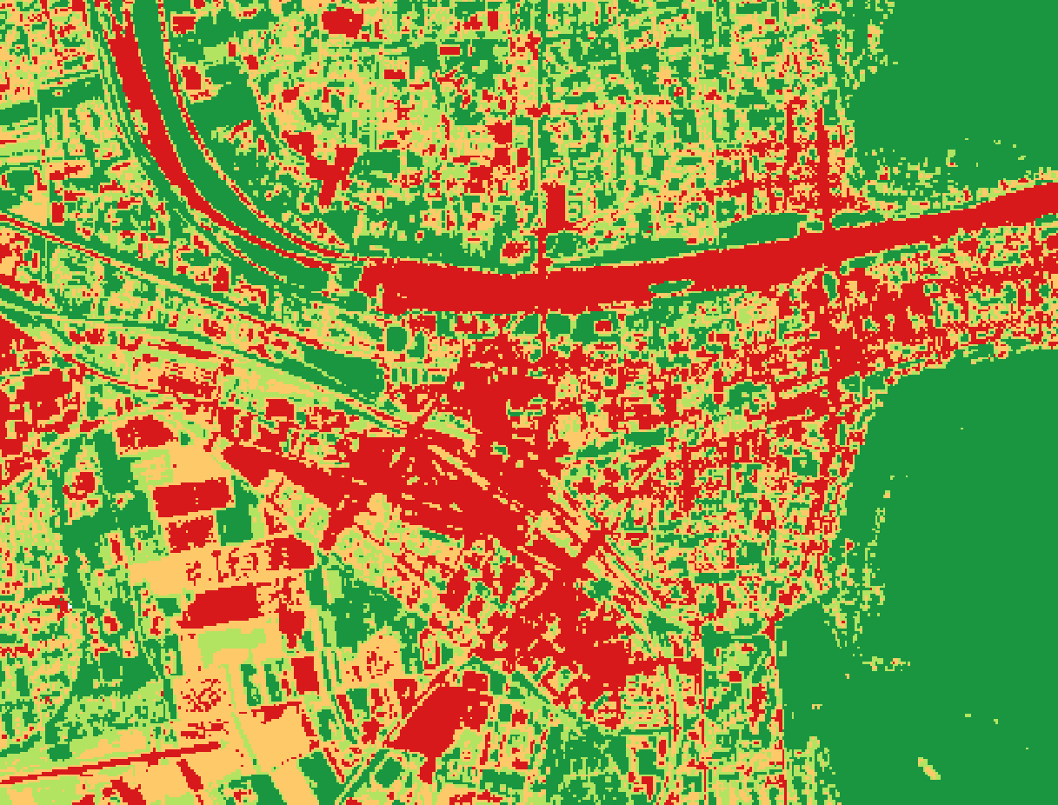
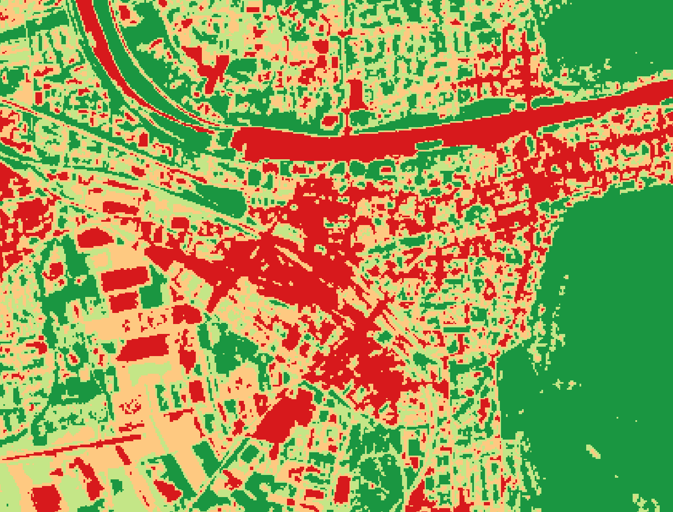
Comparison: Raster Calculator
NDVI calculated with QGIS
NDVI calculated with SAGA
Source: own figure
Source: own figure

Slide 14
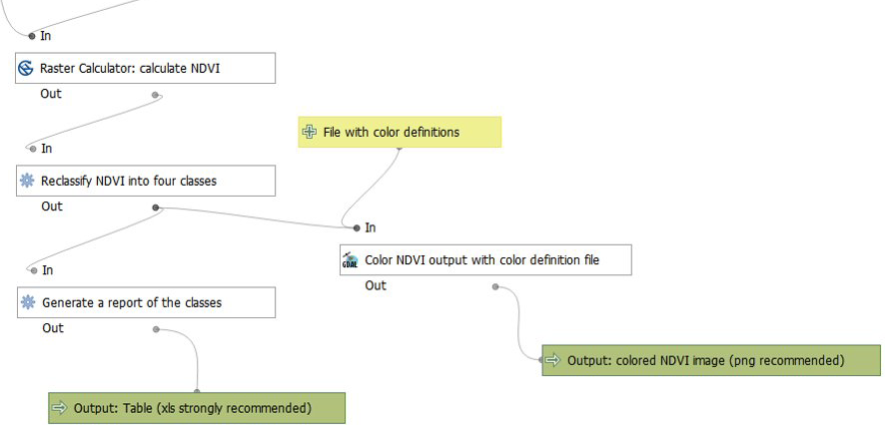
Automation: QGIS model

Slide 15
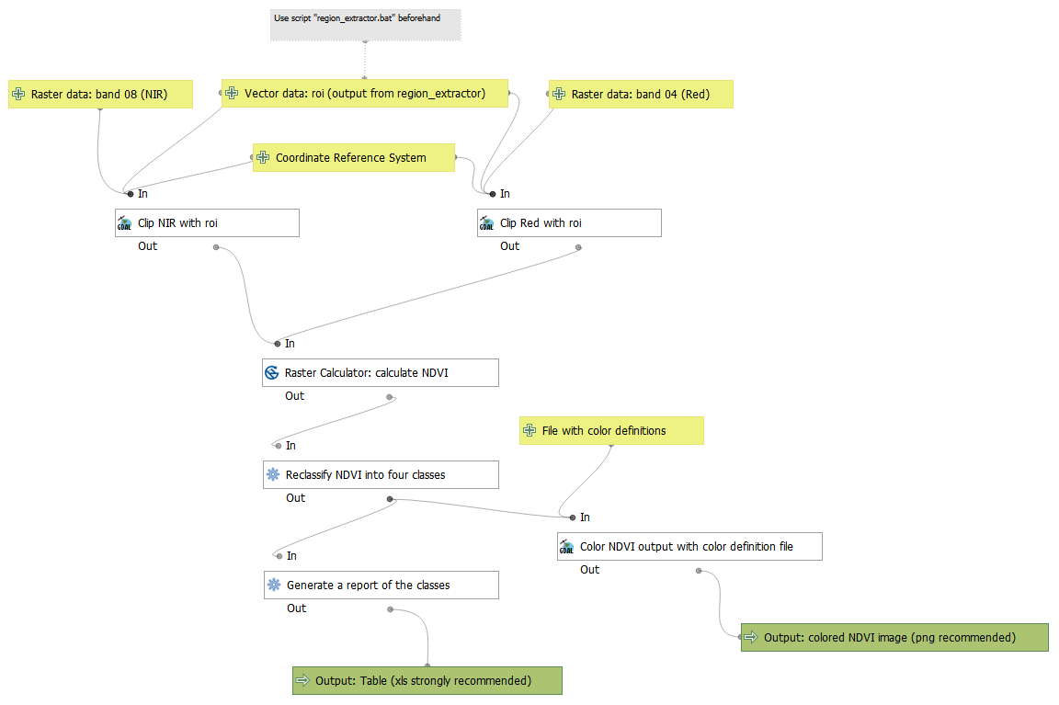

Slide 16
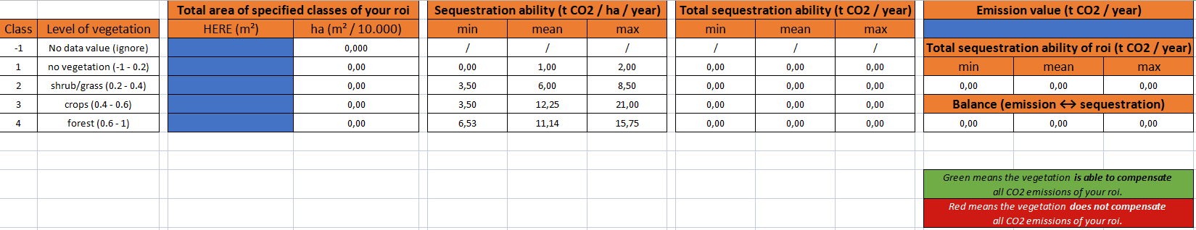
Calculations in Excel
Source: own figure

Slide 17
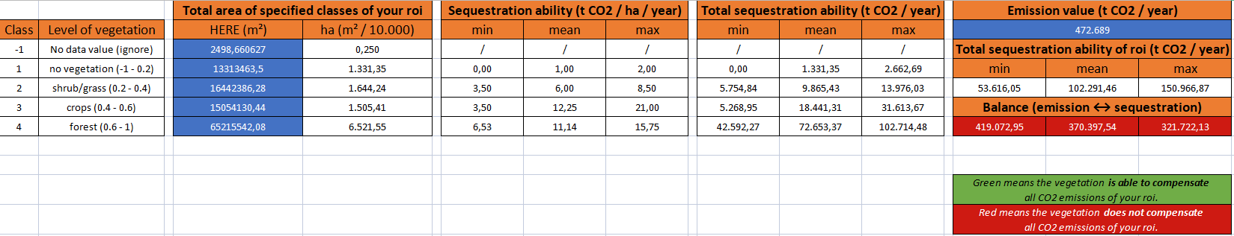
Results
Source: own figure

Slide 18


Discussion: problems/limitations
All values are estimated and not to be taken as scientifically proven
Data for sequestration not adequate for empirical statements – difficult to aquire data in the first place
No up-to-date data for CO₂ emissions (other sources needed)
BUT:
Model is applicable with other data → more accurate data leads to better results
Good tool for getting a first impression of the imbalance between emission and sequestration in a city's extent

Slide 19






Outlook
Further compare the Raster Calculators (other GIS?)
Look for better data sources for sequestration and emission
Implement of roi_extractor.bat into the QGIS model
Automatically import results from model into the Excelsheet
Repository is finished, just needs updating if new implementations work

Slide 20
List of sources
Candiago, S. & Remondino, F. & De Giglio, M. & Dubbini. M. & Gattelli, M. (2015): Evaluating Multispectral Images and Vegetation Indices for Precision Farming Applications from UAV Images. - In: Remote Sensing, 7, pp. 4026 - 4047.
Deutsches Zentrum für Luft- und Raumfahrt e.V. (2022): Die Sentinel-Satellitenfamilie. - URL: https://www.d-copernicus.de/daten/satelliten/daten-sentinels/ [as of: 30.01.2022].
Matese, A. & Di Gennaro, S.F. (2018): Practical Applications of a Multisensor UAV Platform Based on Multispectral, Thermal and RGB High Resolution Images in Precision Viticulture. - In: Agriculture, 8(7):166.
Mkansi, R. (2017): Spectral reflectance of soil, vegetation and water. - URL https://mkansireminder.wordpress.com/2017/04/24/spectral-reflectance-of-soil-vegetation-water/ [as of: 30.01.2022].
Norwegian University of Science and Technology (2018): OpenGHGmap. - URL: https://openghgmap.net/#Heidelberg,%20Baden-Württemberg,%20Deutschland [as of: 30.01.2022].
Zheng, Q. & Huang, W. & Cui, X. & Shi, Y. & Liu, L. (2018): New Spectral Index for Detecting Wheat Yellow Rust Using Sentinel-2 Multispectral Imagery. - In: Sensors, 18, p. 868.

Slide 21

Thank you very much for your attention!

